Slide 1
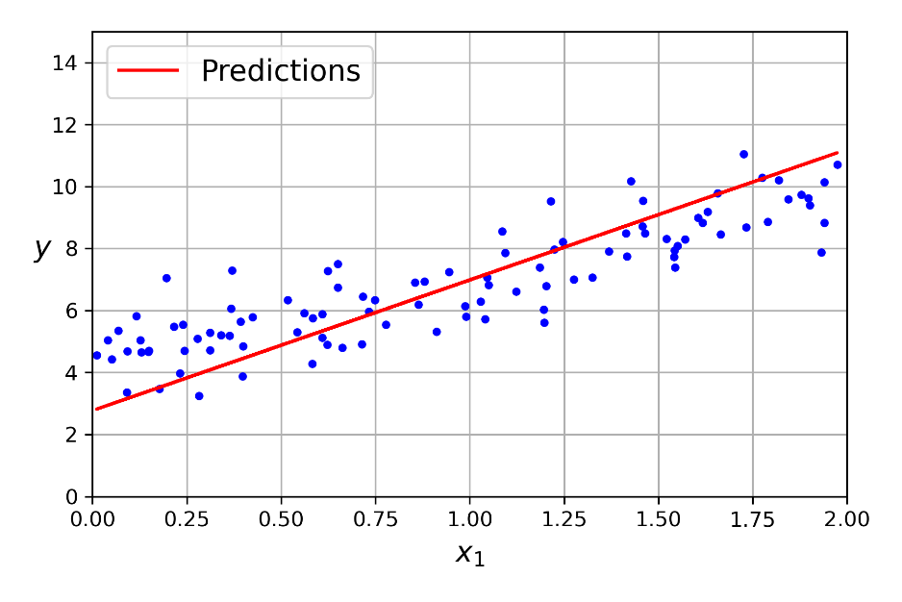
All Types of Cross-Validation Techniques
7
- Dr. Sifat Momen (SfM1)

Slide 2
Learning goals
After this presentation, you should be able to
Apply different Kinds of Cross Validation Techniques

Slide 3
Jupyter Notebook
Please note that there is an associated Jupyter notebook with this presentation
Please use both in parallel for optimal understanding

Slide 4
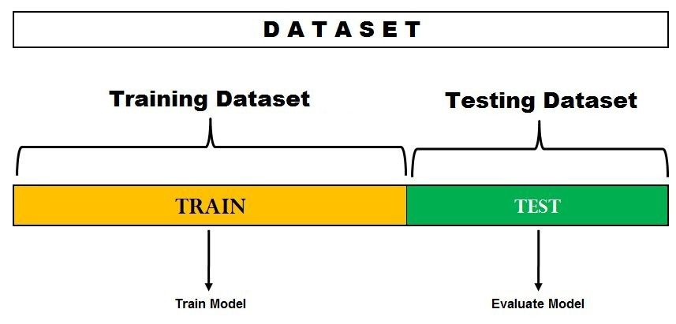
Hold out Validation approach / Train-test split

Slide 5
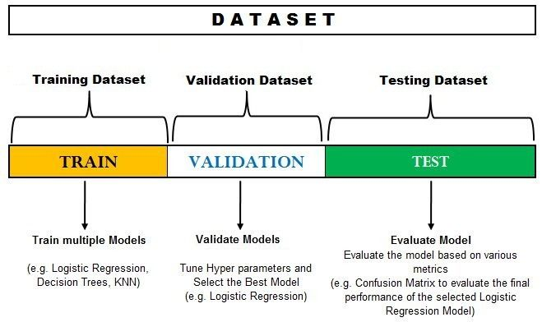
Hold out Validation approach / Train-test split

Slide 6
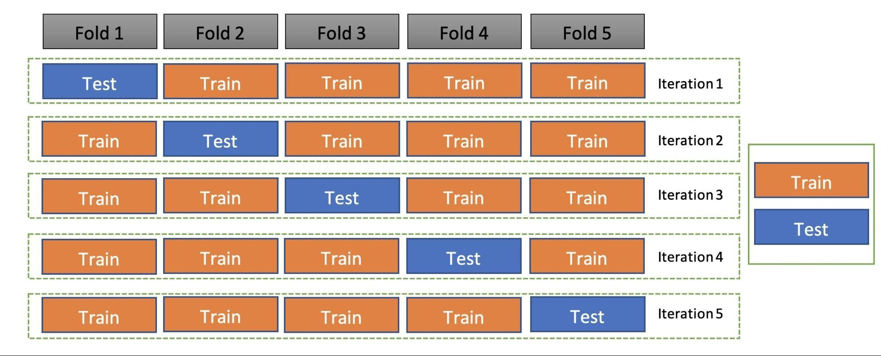
Kfold Cross Validation

Slide 7
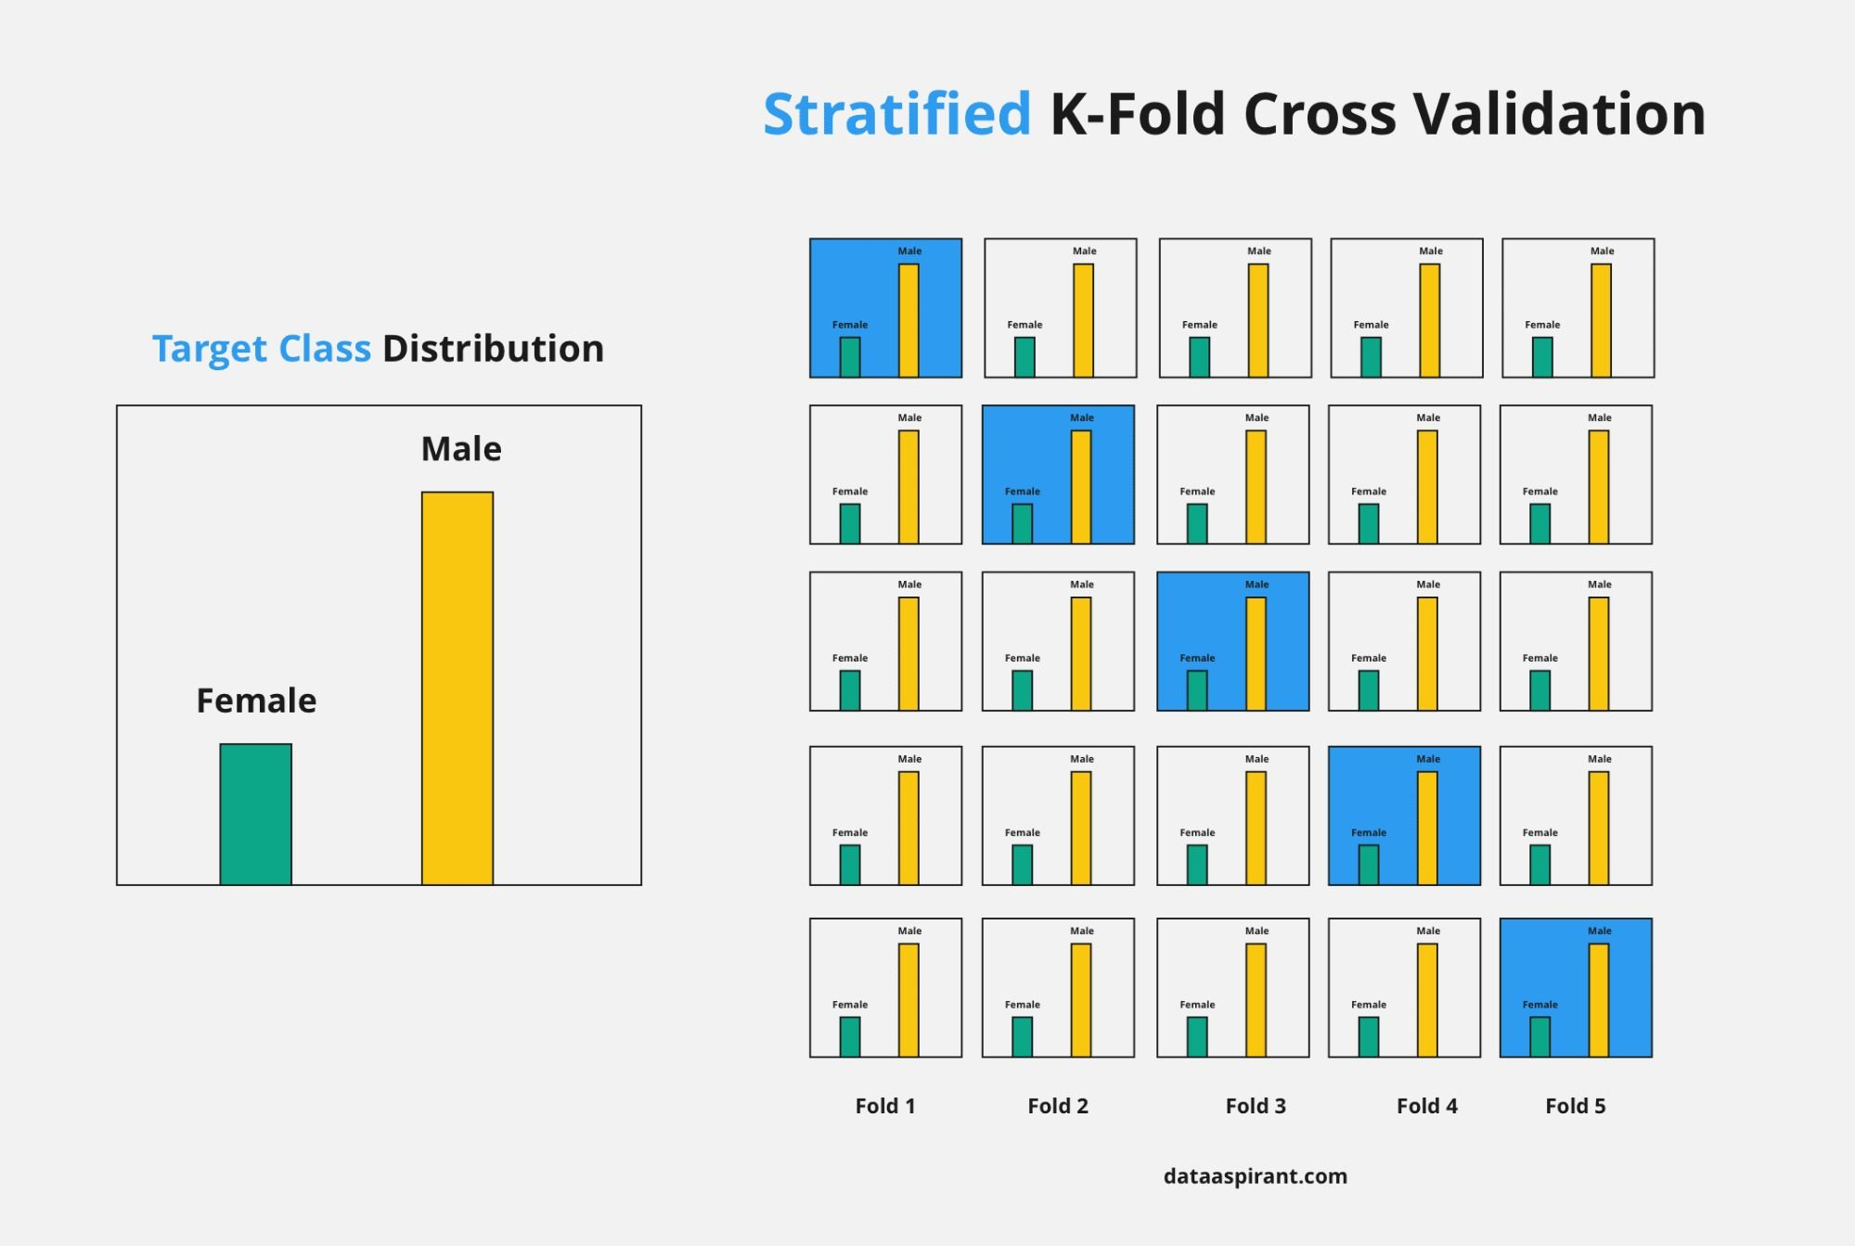
Stratified Kfold Cross Validation

Slide 8
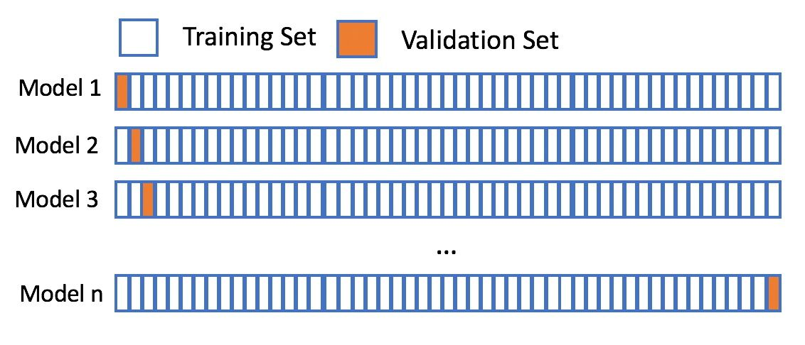
Leave one-out Cross Validation (LOOCV)

Slide 9
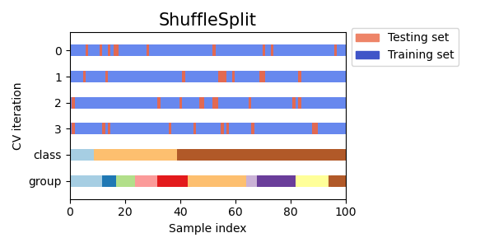
Shuffle Split / Repeated Random Train Test Split

